Slide 1

SWN Monitor
Monitor water usage and health of assets in the smart water network.
Get notified about events and anomolies in the water network like leaks and when acceptable water quality is breached.
Get useful predictions like the amount of water needed for the next day and when to water the garden.
Installation specific.

Slide 2
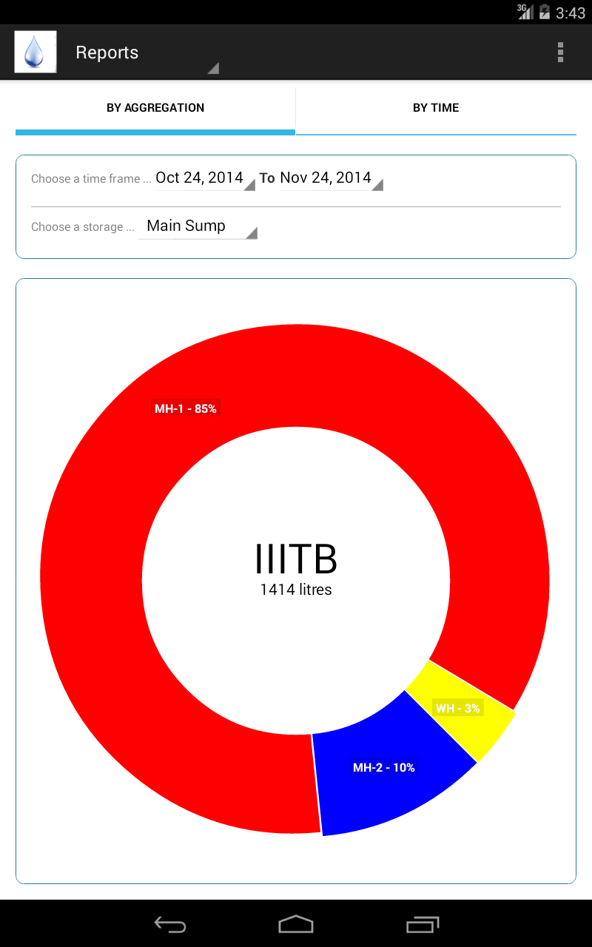
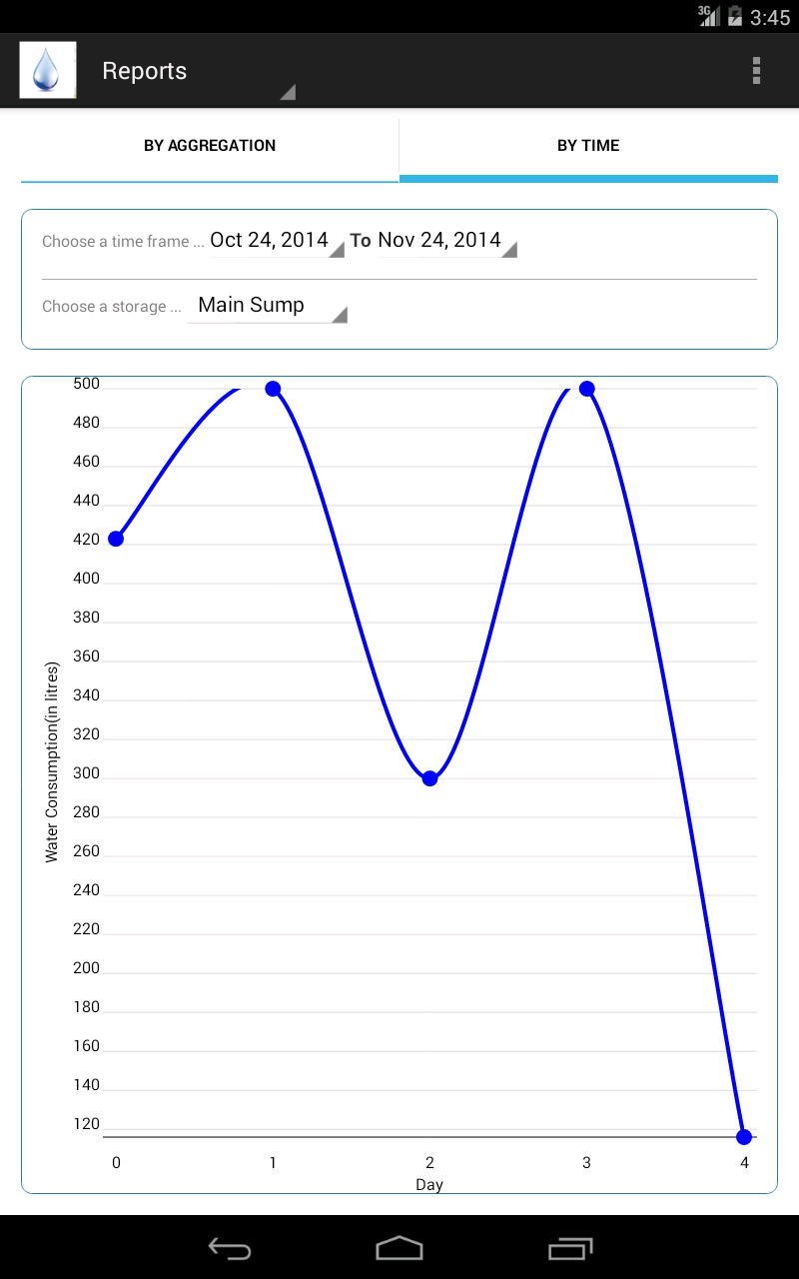
Reports

Slide 3
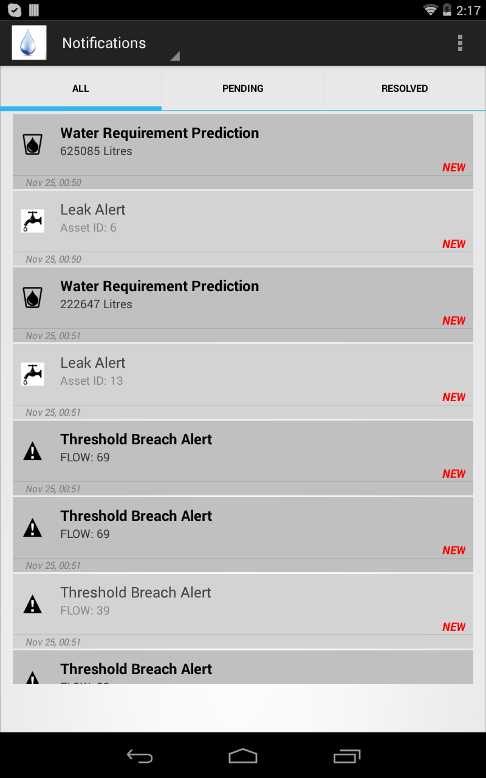
Notifications

Slide 4
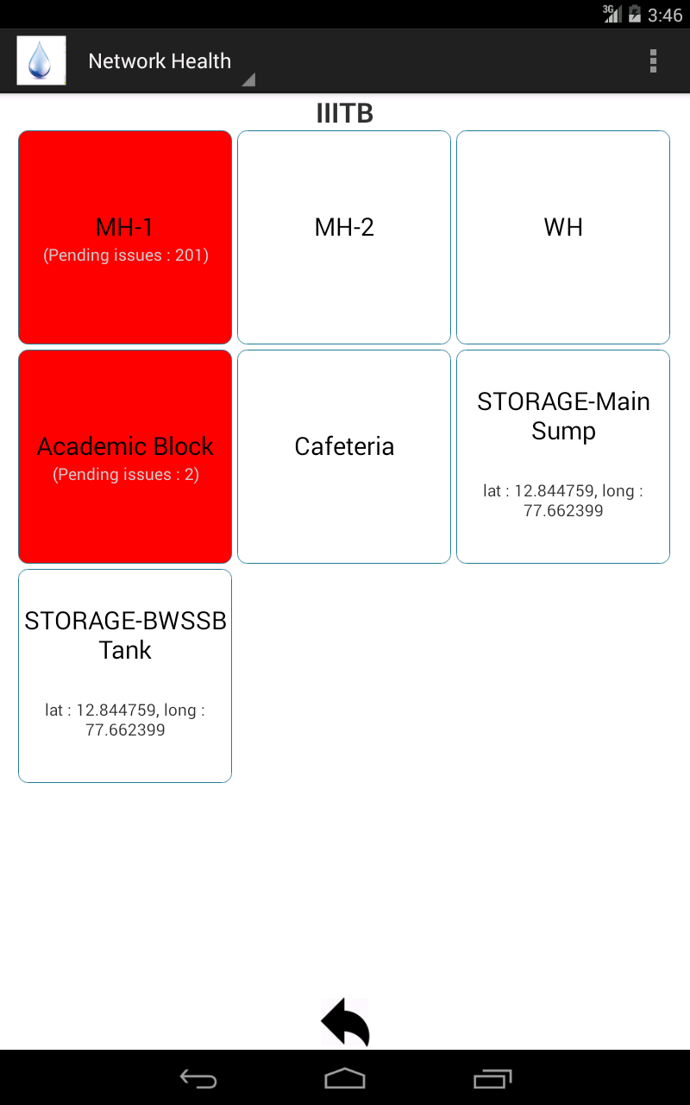
Network Health

